Slide 1
FPGA LPM Component Stop-Watch Counter
JAICHANGPARK
20181017

Slide 2
Aim
Use the FPGA to create a stopwatch counter.
Use the internal clock of the DE2 board to create a frequency divider counter and check the result.
Create a counter that increments every second..

Slide 3
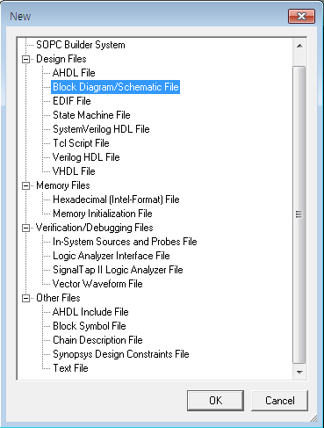
Create new File

Slide 4

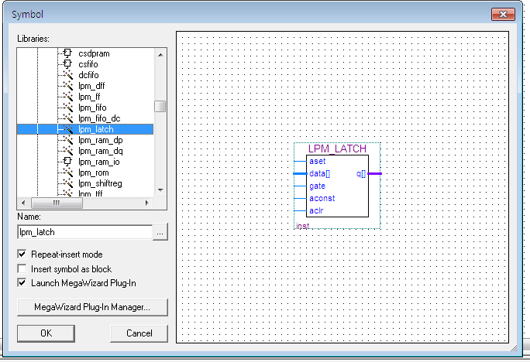
Choose new Symbol block
Symbol

Slide 5
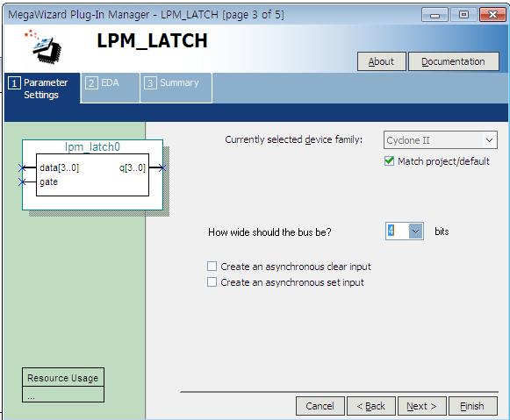
Mega Wizard plug- in manager
비트수 설정
Check none

Slide 6
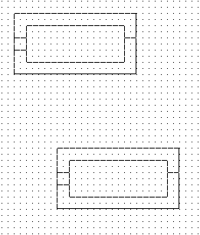
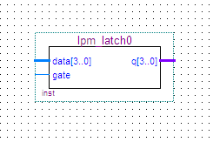
배치 영역 설정
Place the set lpm block on the sketch.
First of all, I created a try block by practice and put it on my sketch.

Slide 7
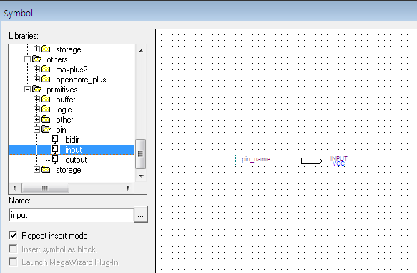
Create input / output pin using lpm symbol manager

Slide 8
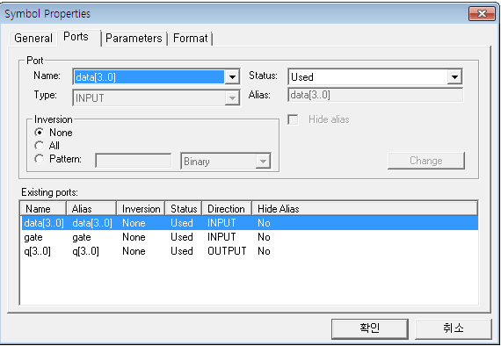
Check and set symbol port properties
After creating the symbol, you can see the set information by entering the attribute of the block.

Slide 9
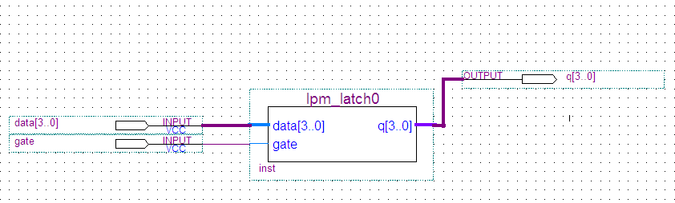
Connection between block and input

Slide 10
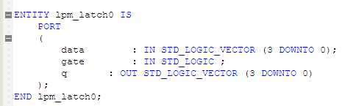

Slide 11
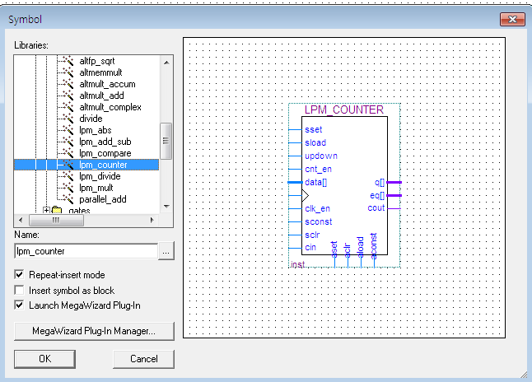
Lpm_counter

Slide 12
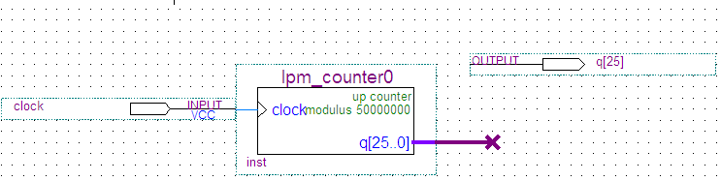
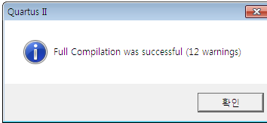
Create a clock divide counter
A counter that divides the internal frequency of 50MHz is needed.
The division ratio for switching from 50 MHz to 1 Hz is 50 million.
So to get a 1Hz waveform with a duty ratio of 50%, set the count value to 50,000 / 2 - 1 = 24,999,999. This count value is 0x17D 783F in hexadecimal, and is 25 bits.

Slide 13
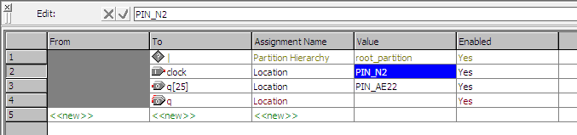

핀 포팅후 재 컴파일

Slide 14
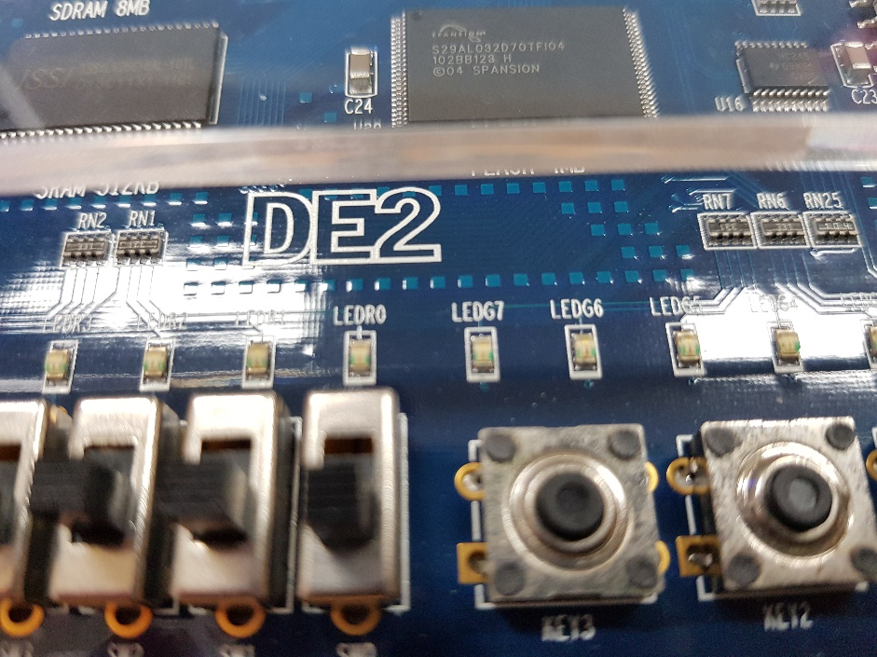
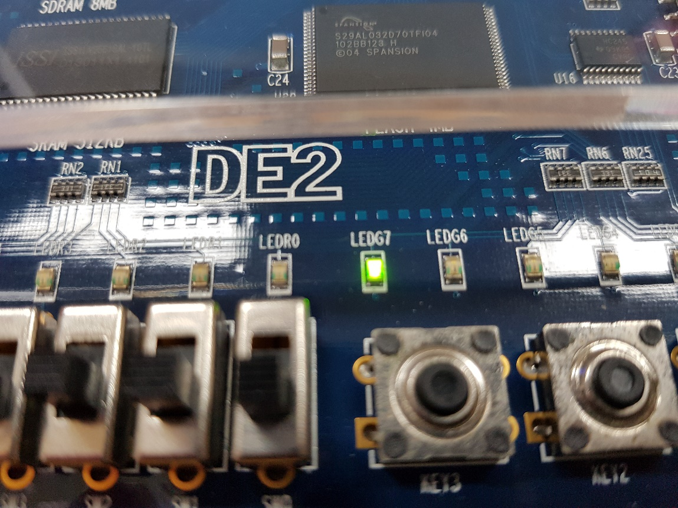
Result of a clock divide counter
1second

Slide 15
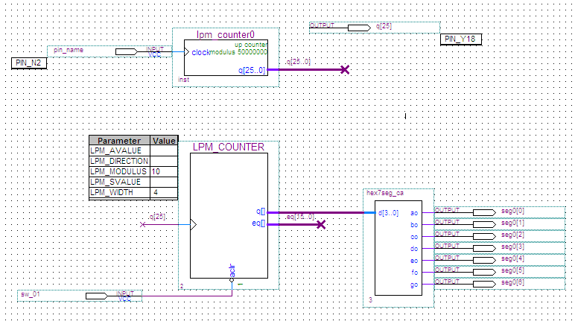
Stopwatch primary block schematic
클럭 분주는
26비트 카운터사용

Slide 16
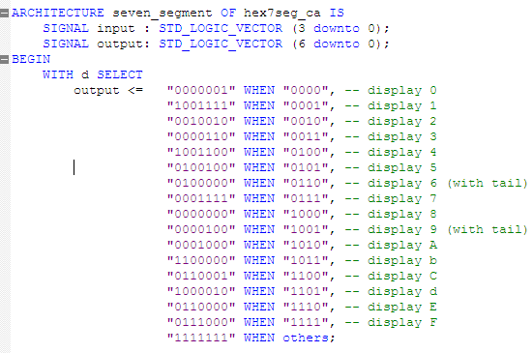
Segment controller block production for segment manipulation

Slide 17
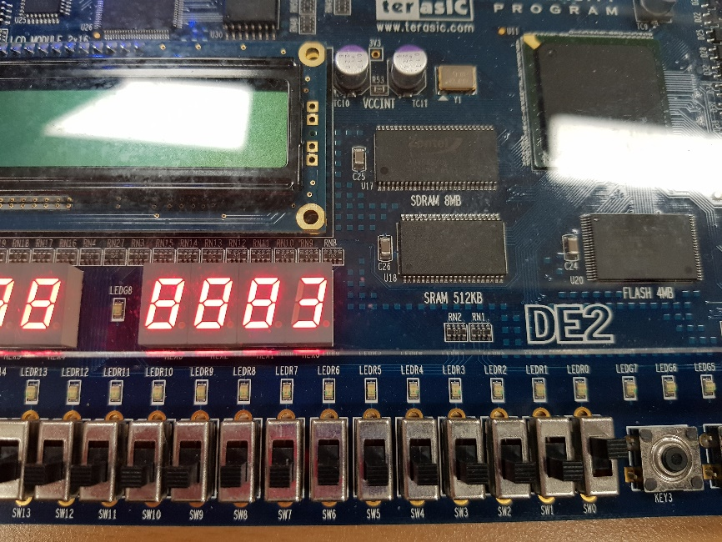
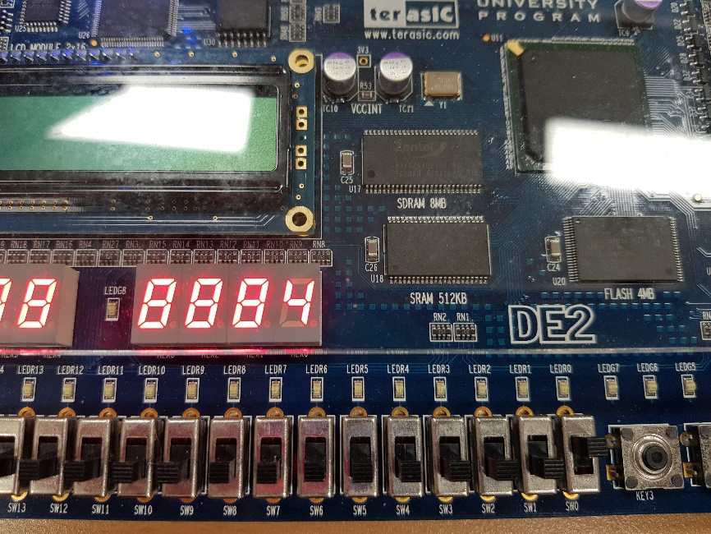
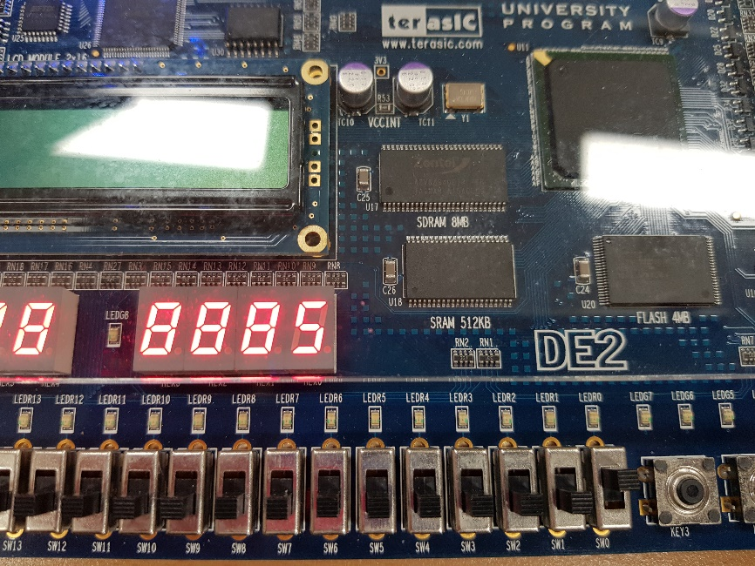
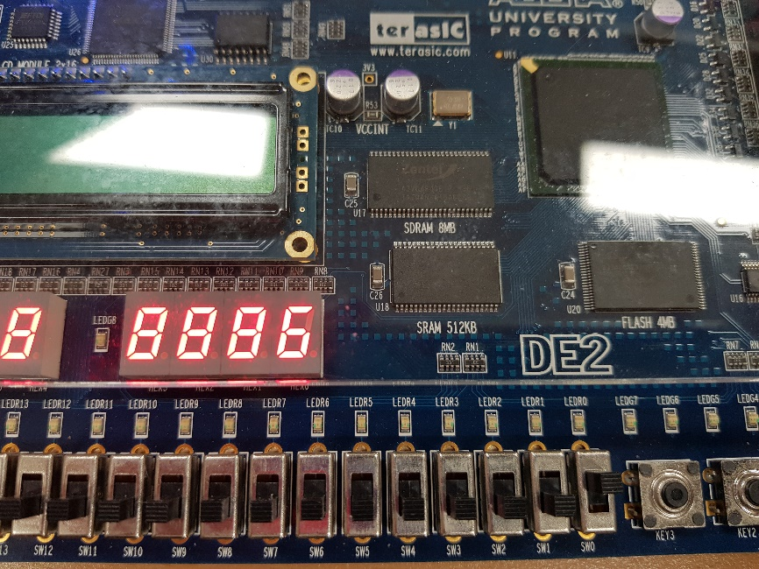
Stopwatch primary block Result

Slide 18
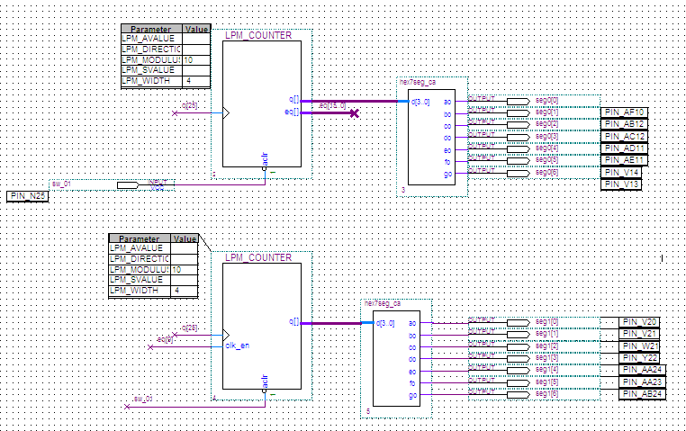
Stopwatch Secondary Block Schematic
SEGMENT
2진수
Switch port

Slide 19
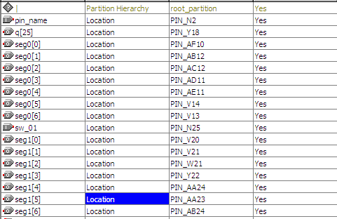
Stopwatch Secondary Block Port Mapping

Slide 20
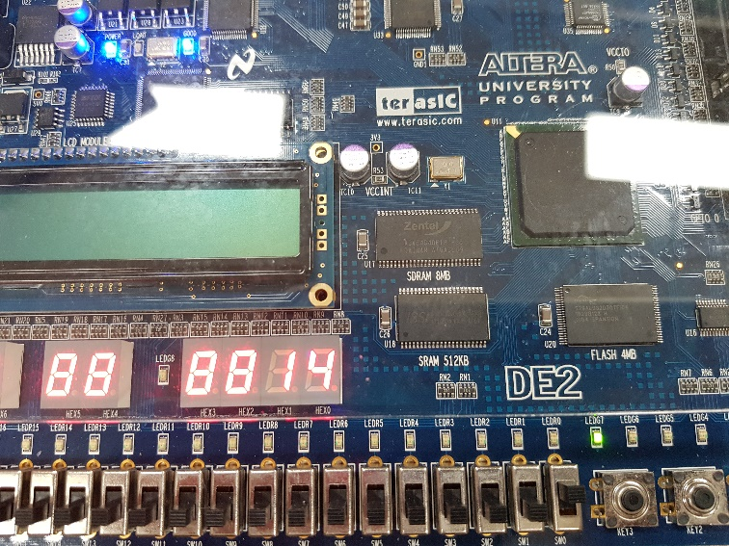
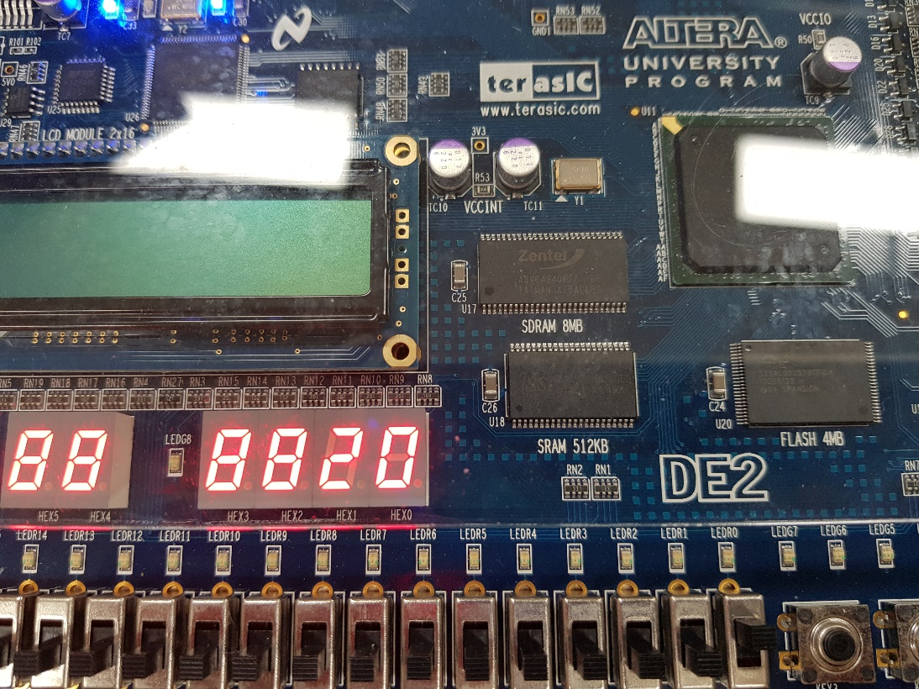
Result of Stopwatch secondary block
If 0-9 is counted, the decimal segment is additionally marked
Therefore, a two-digit decimal stopwatch display was possible.

Slide 21
Thank you

